Slide 1
Notes:
Welcome
Personal introduction

Slide 2
Notes:
More and more people are moving into urban areas but at the same time resources are becoming scarce. At present 75% of the CO2 emissions worldwide are produced by the burning of fossil fuels in the cities. Effective solutions for life in the cities must be found, not only just to reach emission targets.
Smart City is a term now used to describe a range of holistic approaches to urban development. Aimed at making cities greener, more efficient, more caring and more technologically advanced, these design concepts embrace technology-based innovations as well as economic and societal change in urban environments.
One thing common to all these technologies is that they improve quality of life and make our cities more intelligent and environmentally friendly through smart resource management; cities are increasing in size throughout the world, and their structures are growing more complex even as resources become scarcer. Forecasts anticipate that some 85 per cent of the population of Europe will be living in cities by 2050.
Ranked #1 worldwide by the Mercer Consulting Quality of life survey, Vienna is the fastest-growing city in Europe.

Slide 3
URBAN TECHNOLOGIES FROM AUSTRIA
Numerous smart city projects (check here http://www.smartcities.at)
Vienna is one of the most liveable cities in the world
Strong technological & industrial base in mobility, energy & environment, urban development
Notes:
The Austrian competence at Urban Technologies build upon a strong technological & industrial base of numerous Austrian companies that are sometimes world leaders in their niche. Urban technologies include fields like mobility solutions, energy and environmental technologies or comprehensive urban development concepts, is internationally recognized. Products and services of Austrian companies make cities around the world more efficient, more sustainable, safer and more viable.

Slide 4
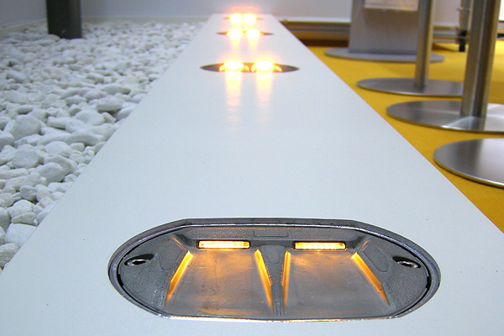
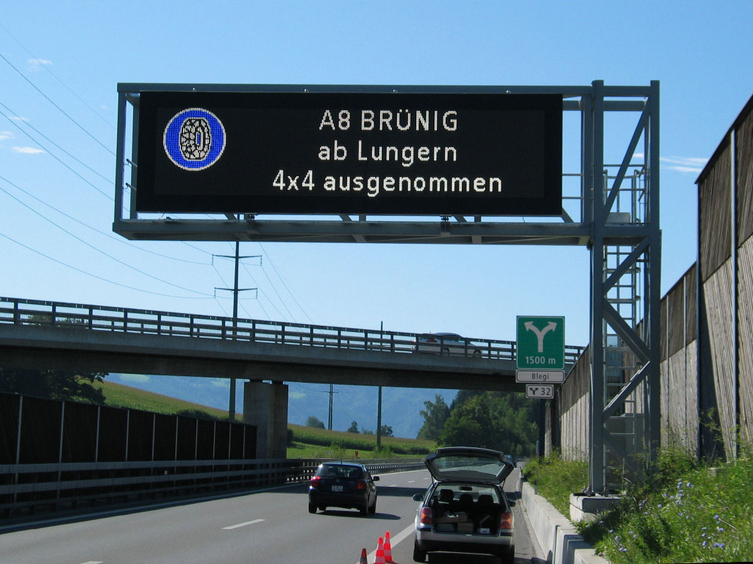
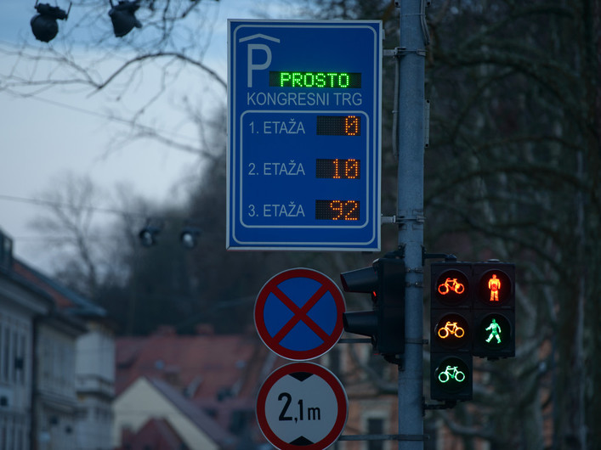
Notes:
High standards in traffic safety:
Wherever you are waiting for a traffic light to change, be it in your car or on foot, you are likely looking at a product by the Austria company SWARCO AG.
The Austrian company is an internationally successful traffic technology group whose products can be found worldwide. SWARCO is the global leader when it comes to traffic lights and LED signal technology. Reflex glass beads and road marking systems, dynamic traffic management systems for motorways and tunnels, traffic signs and signposts, road lighting using LED technology and parking management systems, all provided by SWARCO, can be found in over 60 countries around the world.
SWARCO‘s products, systems and services for traffic safety and intelligent traffic management help maintain the flow of traffic and inform and guide road users in the best possible way. SWARCO‘s complete solutions support society‘s growing need to travel in an energy-efficient and environmentallyfriendly way. A concept with a future.

Slide 5
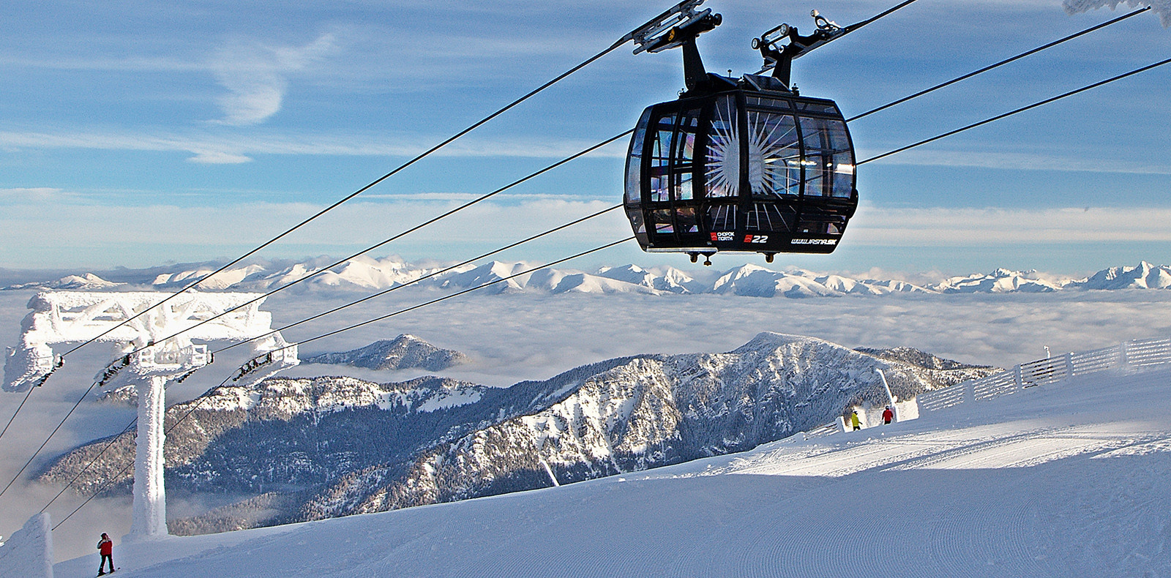
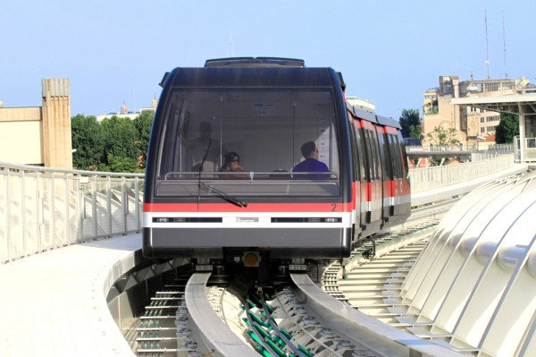
Notes:
Transport systems of the future
Austrian company Doppelmayr Seilbahnen GmbH transports passengers worldwide with their ropeway technology and light rail systems. Whether it‘s in Austria, Las Vegas, Singapore, Toronto, Mexico City, Venezuela or Azerbaijan, Doppelmayr funiculars and cable liners can be found all over the world. Doppelmayr have built the world‘s longest reversible aerial ropeway in Tatev, Armenia. And if you travel by car to Venice, an 830-m cable liner shuttle will take you from the parking garages on the island of Tronchetto to Piazzale Roma with a stop off at the ferry port. With projects all over the world, these are just some of the innovative and efficient passenger transport systems developed by the designers and engineers of the Doppelmayr/ Garaventa Group.

Slide 6
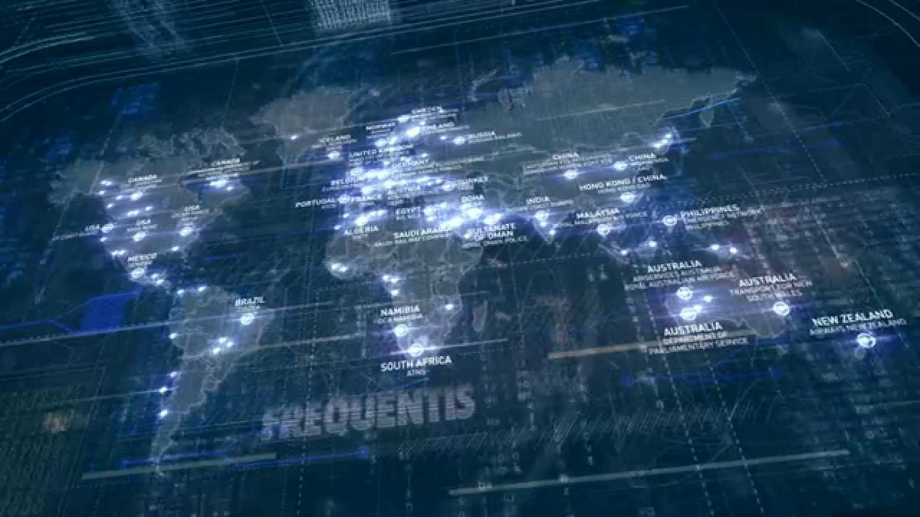
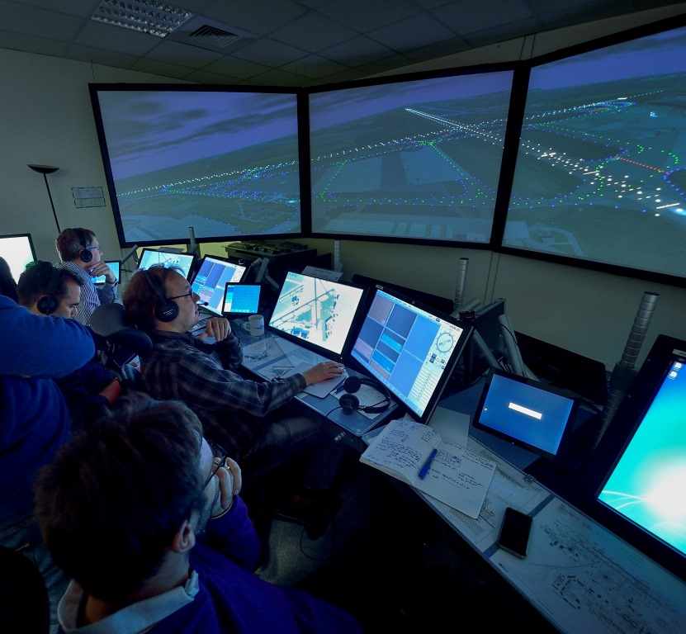
Notes:
Specialists in secure voice communication
What do the European Air Traffic Control Agency Eurocontrol, London‘s Scotland Yard and US Space Agency NASA have in common? They all rely on communication solutions provided by Frequentis AG. The global corporate group based in Vienna has been supplying communication and IT systems for safety-critical applications since 1947 — whether it‘s for civil or military air traffic management, the area of public safety (police, fire, rescue service) or for rail and maritime systems. Customers in more than 110 countries around the world place their trust in Frequentis solutions and project expertise. The main drivers of the company‘s market success are its innovative strength and technological focus, with particular attention paid to an optimised human machine interface. With a market share of 30%, Frequentis is the global market leader of voice communication systems for air traffic management.

Slide 7
Smart technologies from Austria for the cities of the future
Notes:
You can find out more about the range of services provided by the Austrian Smart City/Smart Technologies sector in the latest edition of FRESH VIEW, the industry specialist magazine, which showcases more than 160 Austrian firms from the ‘Smart Mobility’, ‘Smart Energy and Environmental Technology’, ‘Smart ICT Infrastructure’ and ‘Security’ sectors:

Slide 8
Business opportunities on www.advantageaustria.org
Urban Future Global Conference in Vienna Feb 28 – Mar 2, 2018 www.urban-future.org

Slide 9
Благодаря ви!
ADVANTAGE AUSTRIA София
+359 (2) 953 15 53
sofia@advantageaustria.org
www.advantageaustria.org/bg

