Slide 1
In the name of SMART cities
Стефан Малиновски
Ръководител Интелигентни системи

Slide 2


Защо сме тук?

Slide 3






























Историята на Телелинк
2001
Establishment of Telelink
---
Launching Network Infrastructure
2004-2005
2006-2007
Establishment of Telelink Serbia and Macedonia
2008-2011
Entering Montenegro
---
Acquisition of Comutel Serbia
2012-2014
Establishment of Telelink BiH and Slovenia
2015-2016
2017
  Launching Systems Integration
  Launching Security & Automation
Establishment of Telelink Germany
  Reorganizing core Bulgarian operations in 3 new focused subsidiaries under a Bulgarian holding company
Cisco Silver and Gold Partner awards
CORPORATE
  Developing advanced Microsoft partnerships
Establishment of Telelink United Kingdom
Establishment of Telelink Romania
17 години успешно развитие
2001-2003
Starting as a subcontractor and taking over as prime contractor for the rollout of Bulgaria’s 2nd MNO Globul (now Telenor)
2004-2005
Prime contractor for the Fixed NGN and 3rd Bulgarian MNO launched in Vivacom
---
Prime turn-key contractor for the 3rd Romanian MNO operator
2004-2007
2008-2011
2011-2013
2014-2015
Today
1st major projects with Governmental and Enterprise accounts
Post-acquisition growth in key Comutel client SBB
Expanding SBB partnership to sister telcos Telemach in Bosnia and Slovenia
  Direct contractor of DT and Vodafone UK
  Combining perimeter security know-how with progressive Microsoft platforms and Data Analytics in Bulgaria's EU Presidency Security project
COMMERCIAL
  Breakthrough in ITS with projects for the Road Infrastructure Agency and the cities of Sofia, Plovdiv, Pleven and St. Zagora in Bulgaria
Prime contractor for the rollout of Telekom Austria's VIP MNOs
Implementing the 1st Regional Broadband and Border Security Projects in Bulgaria
Taking over vendors as exclusive outsourcing partner of Telekom Austria’s Bulgarian MNO Mtel
  New products and services targeting 700 European cities and 5+ new markets from MENA to the US

Slide 4

Да започнем с малко исторически данни…

Slide 5


Световната тенденция…1960
~34%
~66%
Източник: Световна Банка

Slide 6
Световната тенденция…1980
~40%
~60%
Източник: Световна Банка

Slide 7
Световната тенденция…2000
~50%
~50%
Източник: Световна Банка

Slide 8
Световната тенденция…2016
~55%
~45%
Източник: Световна Банка

Slide 9
Световната тенденция…2050
~70%
~30%
Източник: Световна Банка

Slide 10

…2000
~70%
~30%
Източник: The Guardian

Slide 11
…2016
~74%
~26%
Източник: The Guardian

Slide 12


Предизвикателствата

Slide 13

В основата на решението…
Дигитализация

Slide 14










Да навържем точките…

Slide 15
Предизвикателствата…

Slide 16


Често срещана практика
Липса на интеграция между информационните системи източници на информация …

Slide 17
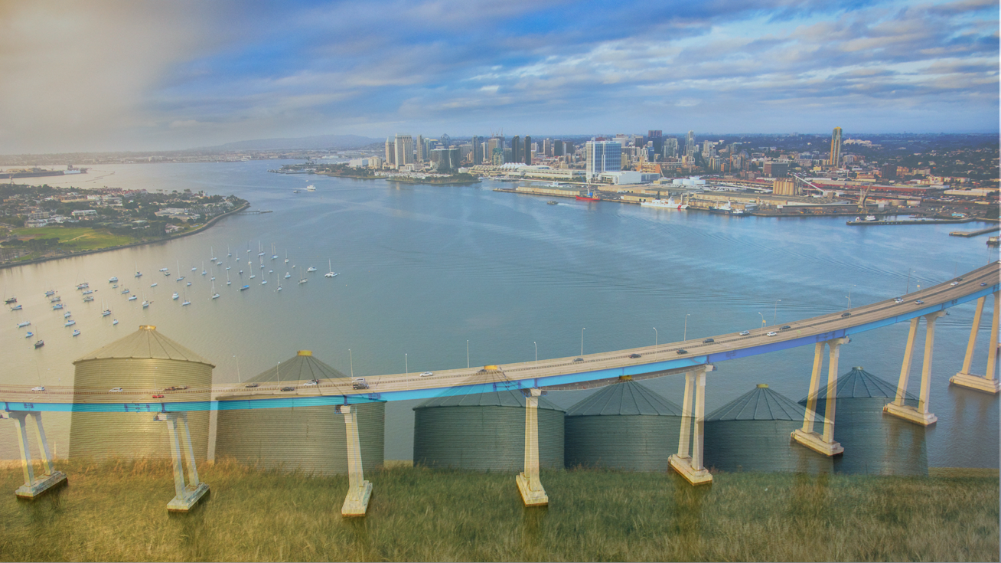
Нашият подход…
Интегриране и добавяне на аналитики
Systems of
Record
Systems of
Intelligence

Slide 18

Big Data
Нарастващи обеми от информация в градовете от различни източници
Notes:
NEW INSIGHT (:30)
Our new awareness and connectivity are enabling increasingly higher octaves of insight - advanced innovation and analytics – that give us the ability not only to understand, consume and digest what we see, but to distill and formulate new and actionable insights. Insights we can use with increasingly facility to detect, predict and anticipate events and developments before they become physically manifest.
[Briefly touch upon key audience-relevant samples: ]
Database Expansion
Statistical Analysis
Signal Traffic Analysis
Geospatial Mapping
Chronological Mapping
Threat Detection
Trend Analysis
Predictive Modeling
Data Visualization
Voice Recognition
Facial Recognition
Subject/Object Isolation

Slide 19
Нашите решения...

Slide 20
Софтуер за управление на билетна система
Мобилни приложения
Уебсайт
WE MAKE PEOPLE
ENJOY THEIR CITY.
STARA ZAGORA AFC
3 центъра за издаване на билетни продукти
77 превозни средства
10 TVM
50 устройства за контрольори

Slide 21
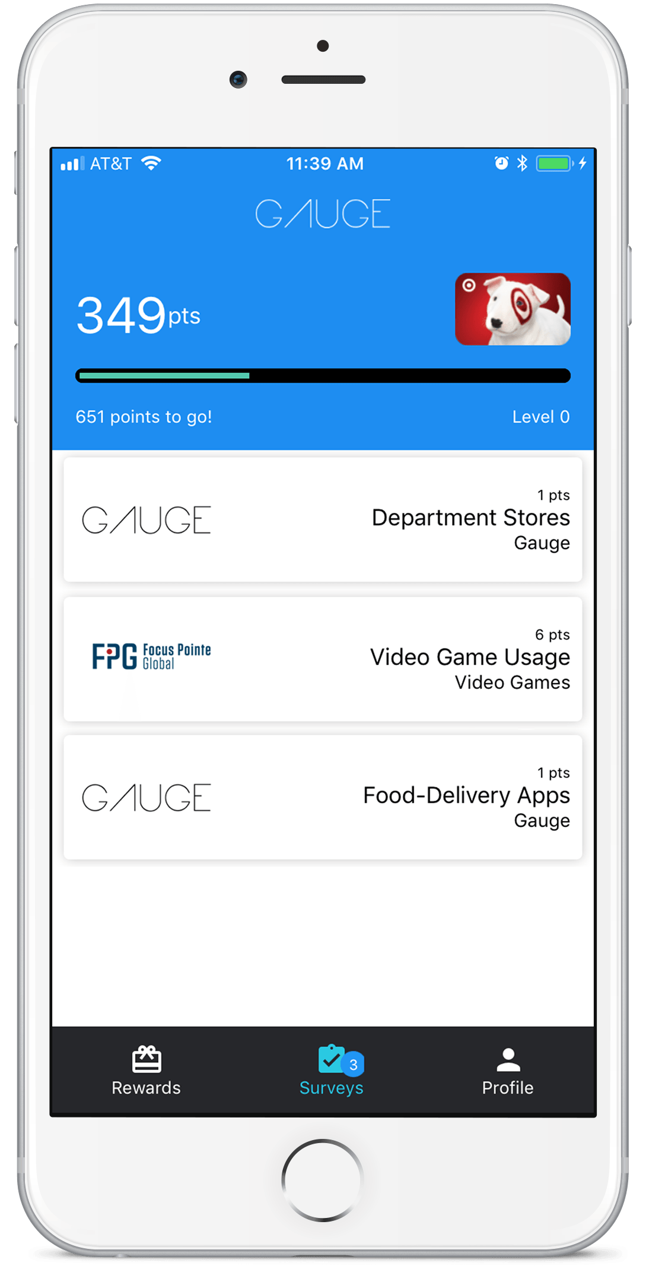
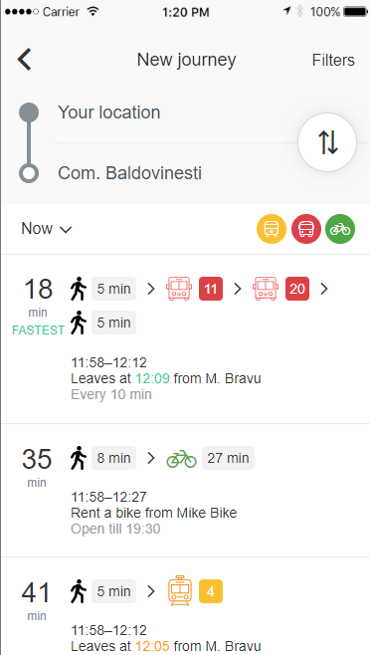
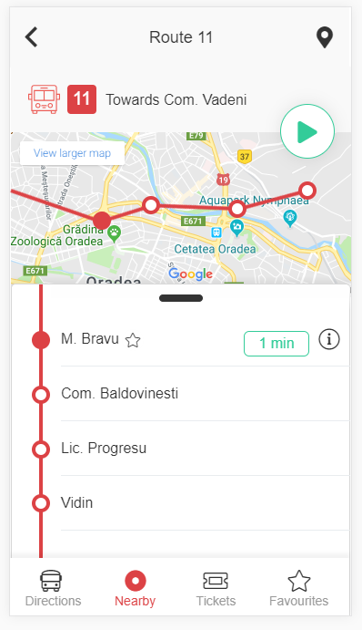

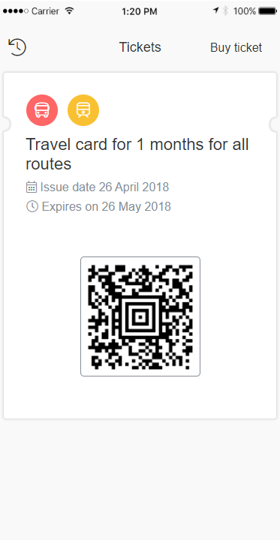




User Experience

Slide 22
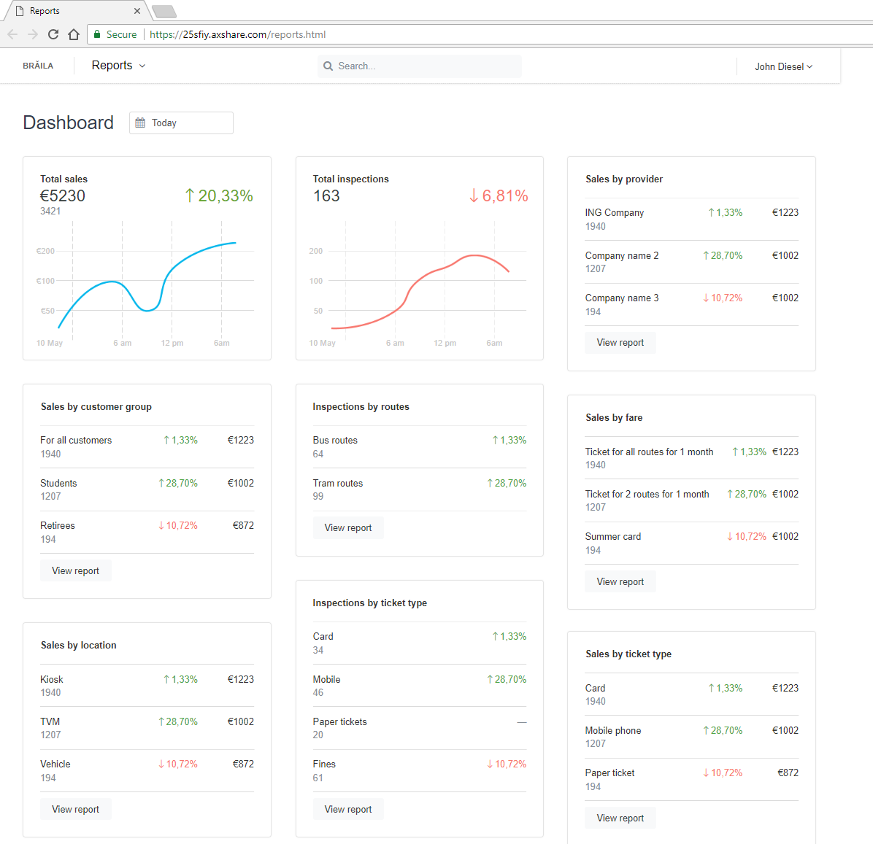
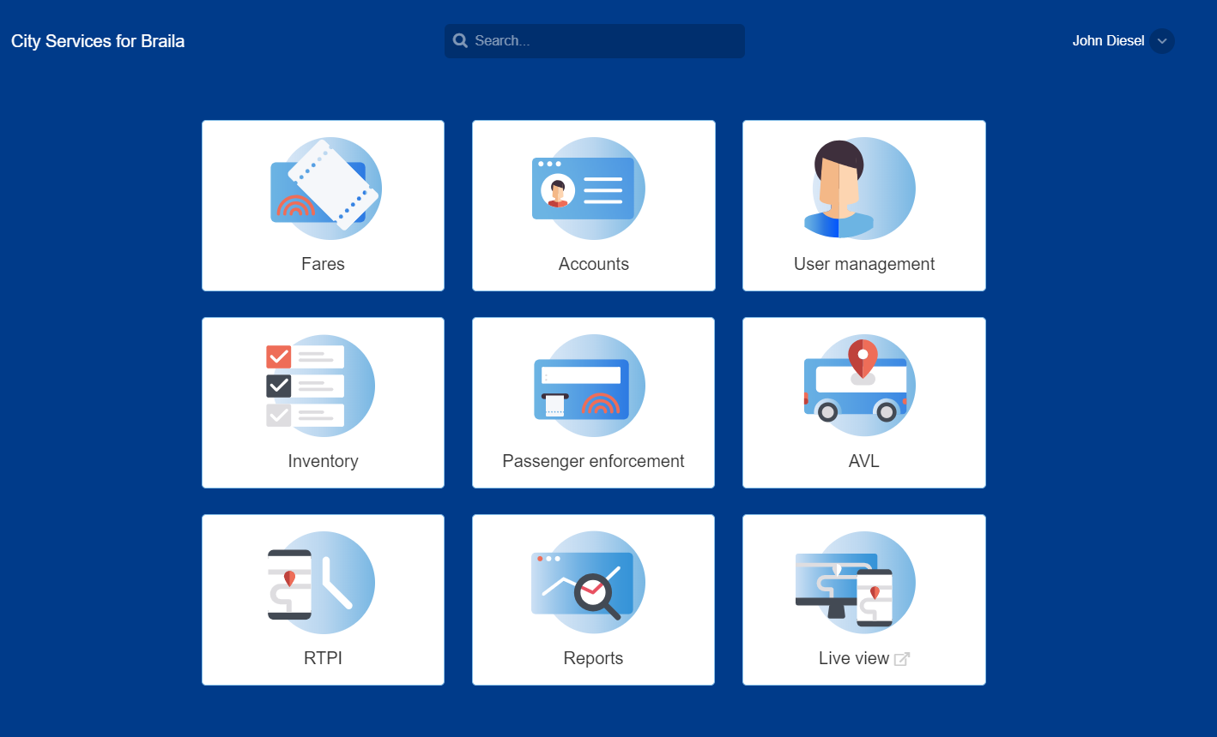
Back-Office

Slide 23
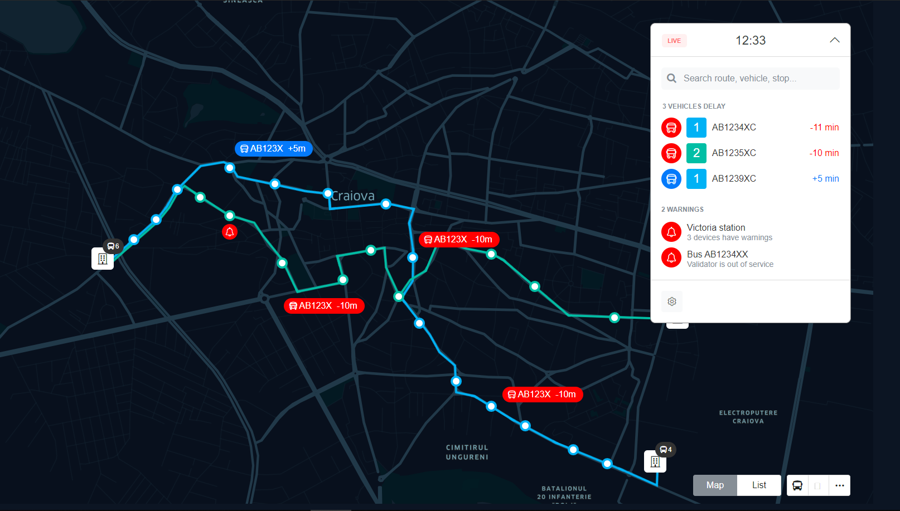
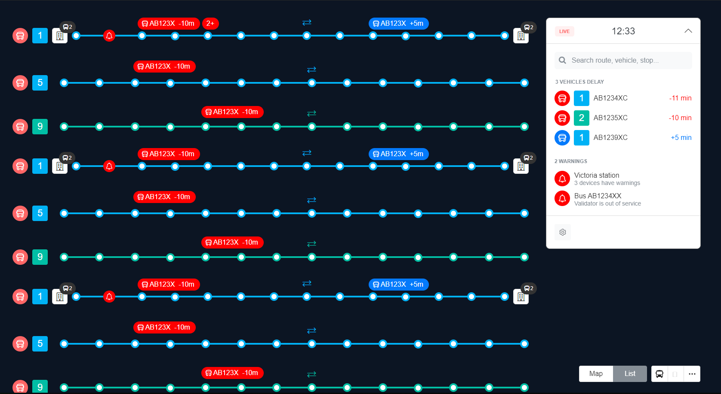
Live View

Slide 24

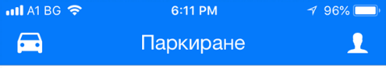
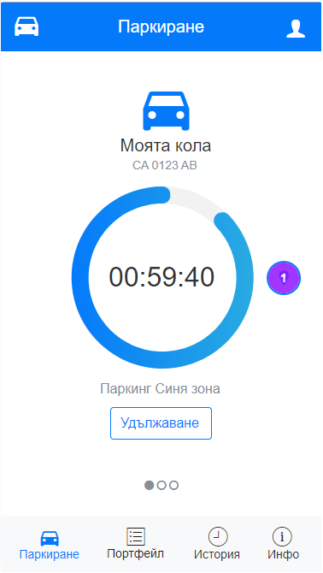

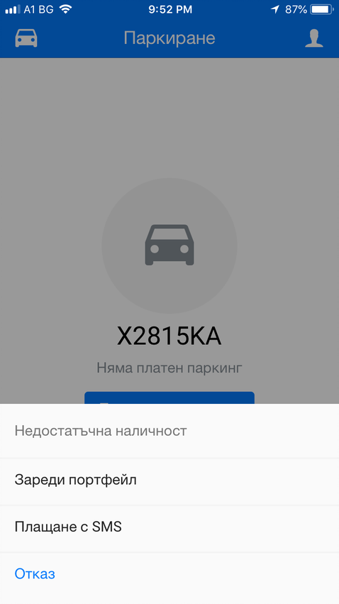
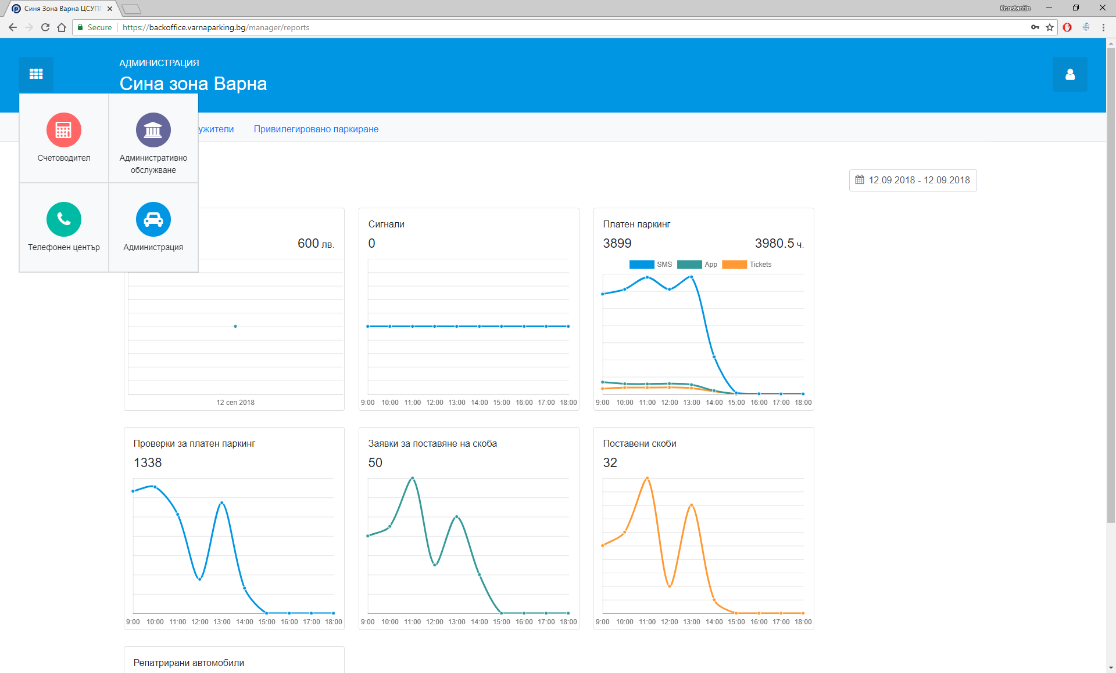
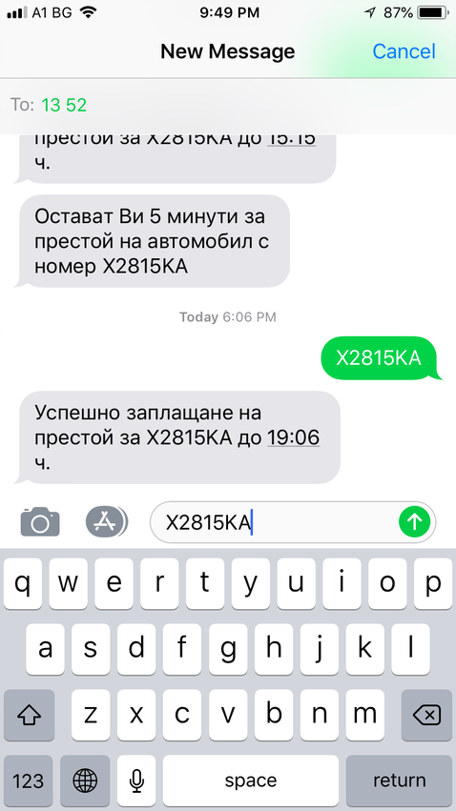
Smart Parking

Slide 25
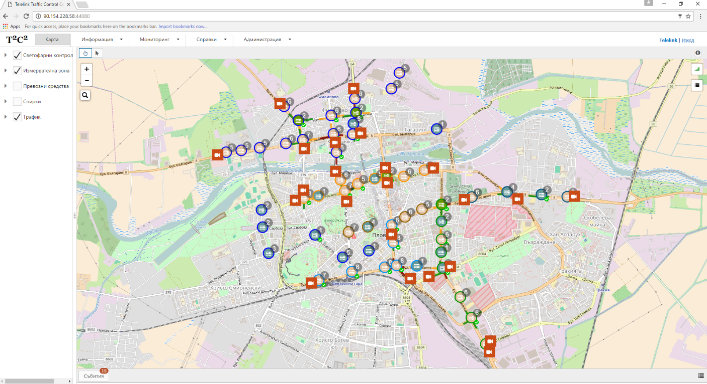
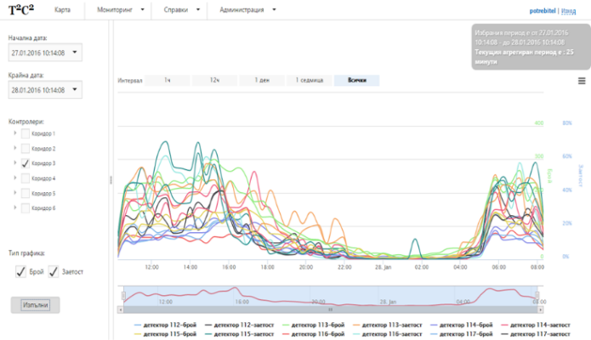
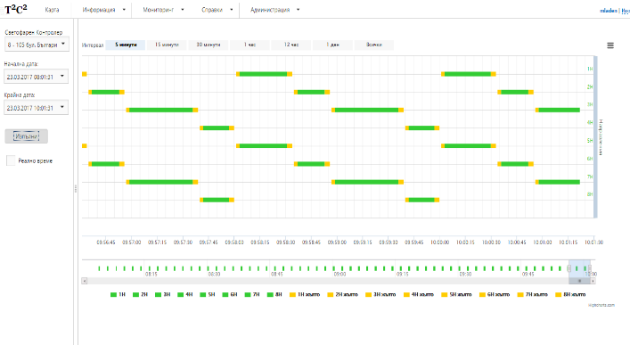
Telelink Traffic Control Center (T2C2)

Slide 26
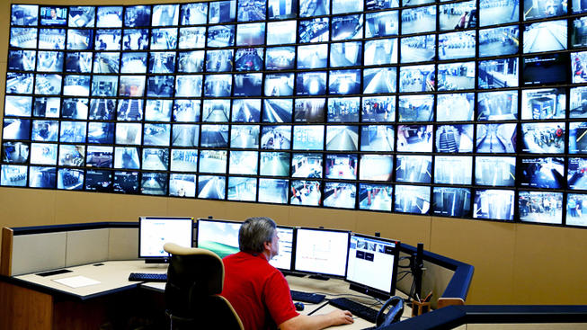
CCTV...the typical scenario

Slide 27
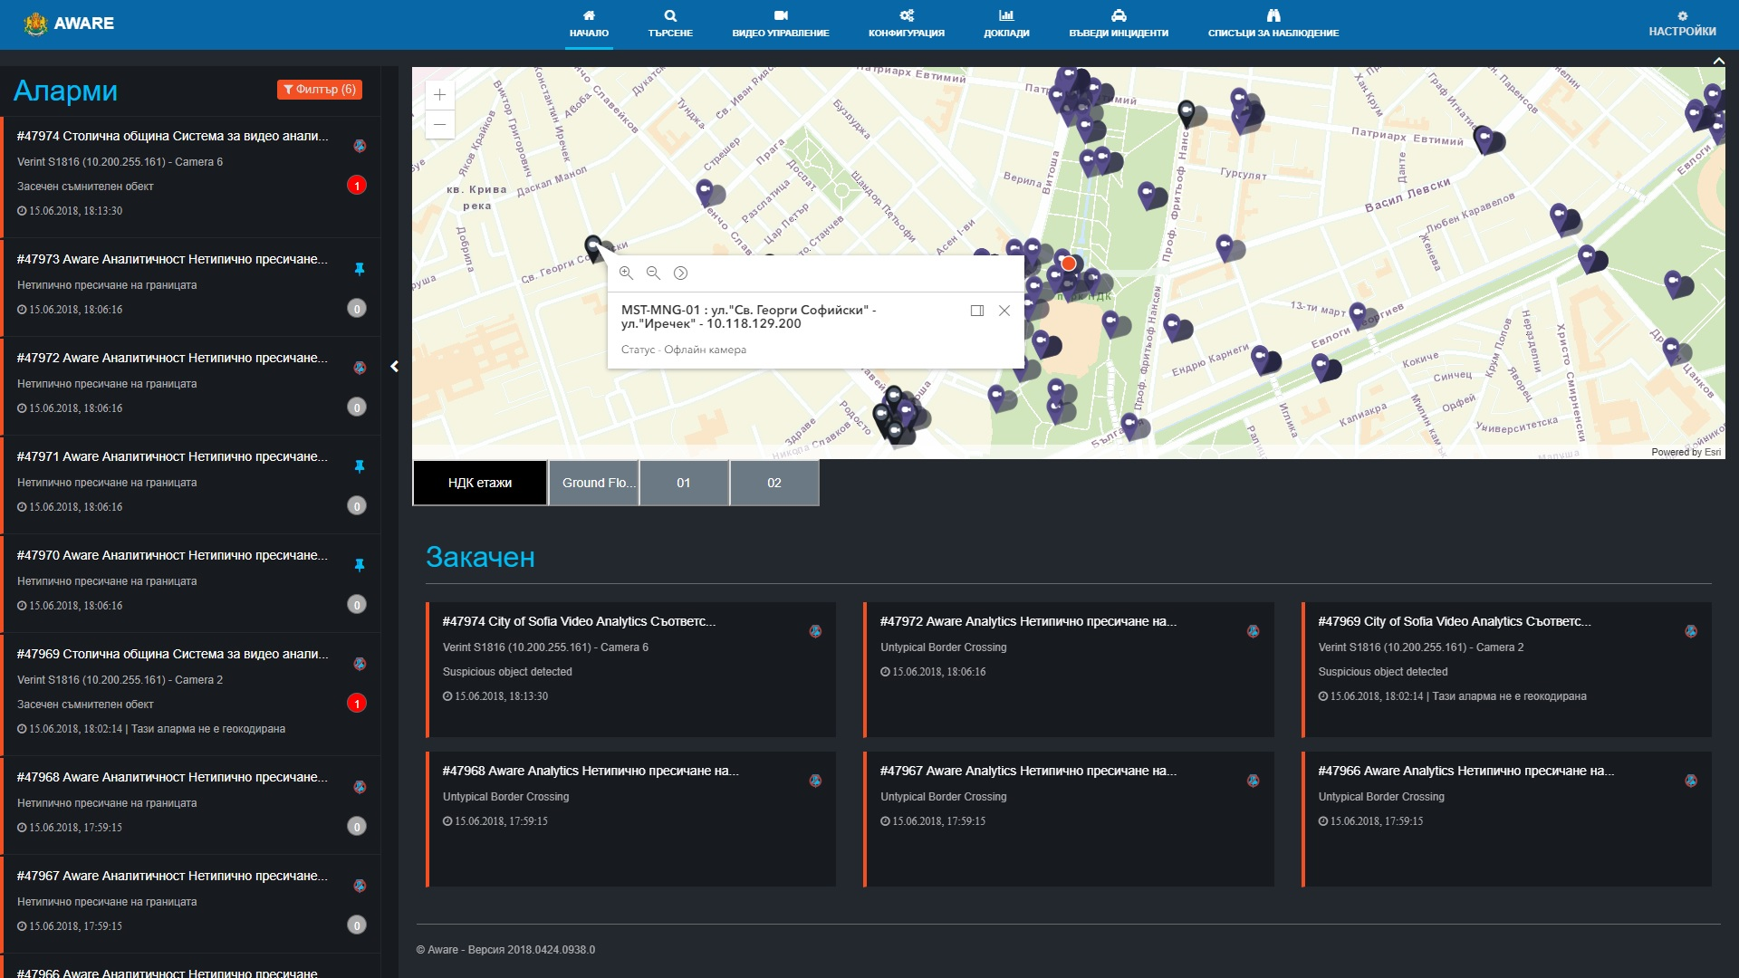
MoI Intelligent Surveillance
Alert Panel
Incident Map Panel
Correlation Workbench

Slide 28
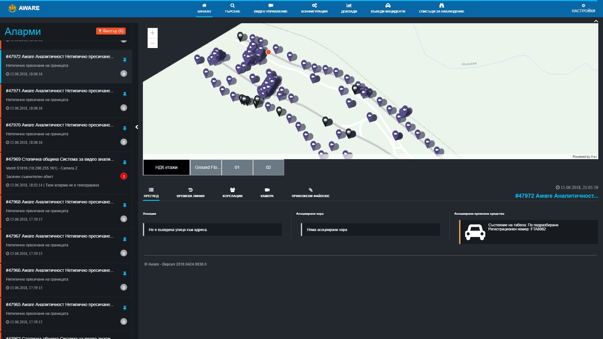

Slide 29





Environment monitoring
Store
and Visualize
Fuel
Data Analytics
Sense
Transmit

Slide 30
Ползите
Максимална оптимизация на разходи (без дейтацентър, поддръжка, висококвалифицирана експертиза)
Без скрити разходи, бизнес модел “As-a-service”
Според конкретните нужди на общината и гражданите
Бързи за внедряване
Максимална степен на надеждност
Високотехнологична и модерна визия
GDPR отговарящи
Отворена за интеграции

Slide 31
БЛАГОДАРЯ ВИ ЗА ВНИМАНИЕТО!

