Slide 1
ANGEL ZAHARIEV
A&A ARCHITECTS Sofia
www.aaa.bg

Slide 2
КАК СЕ ПРОМЕНЯТ ГРАДОВЕТЕ
В РЕЗУЛТАТ НА РАЗВИТИЕТО НА ТЕХНОЛОГИИТЕ?

Slide 3
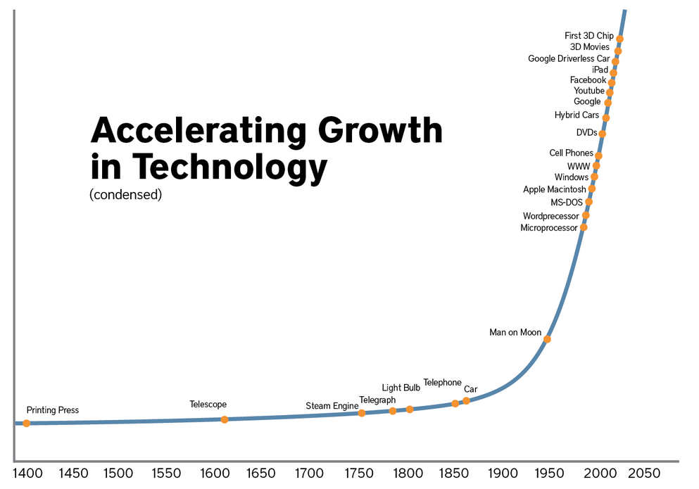
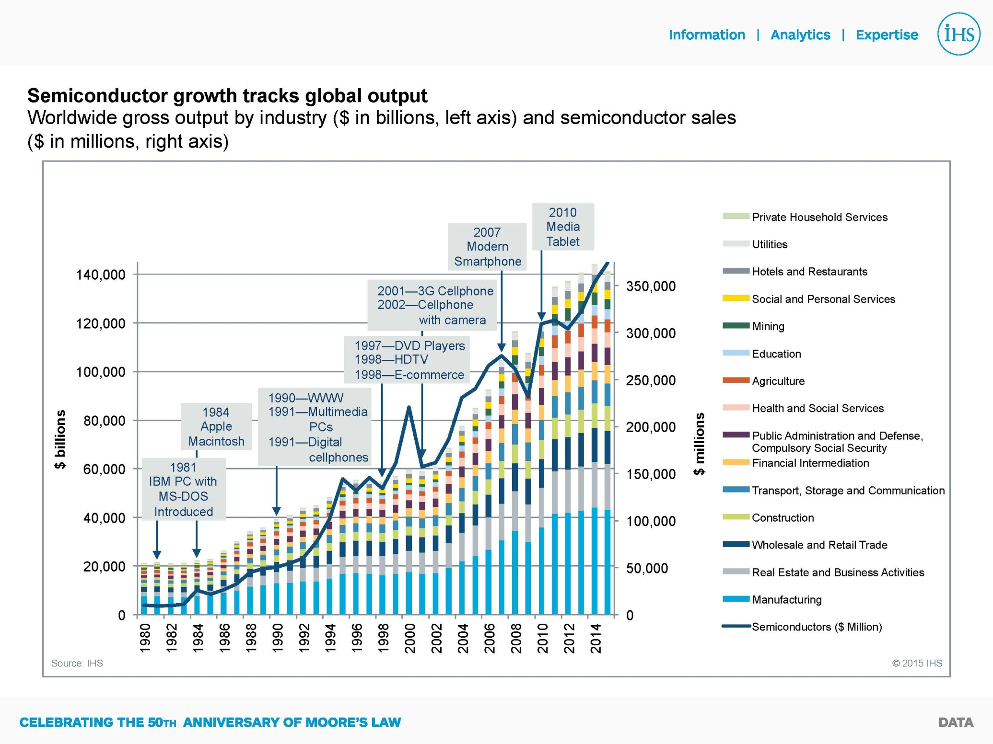
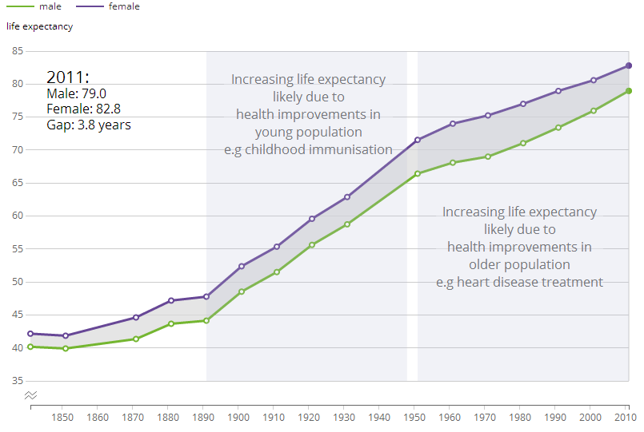
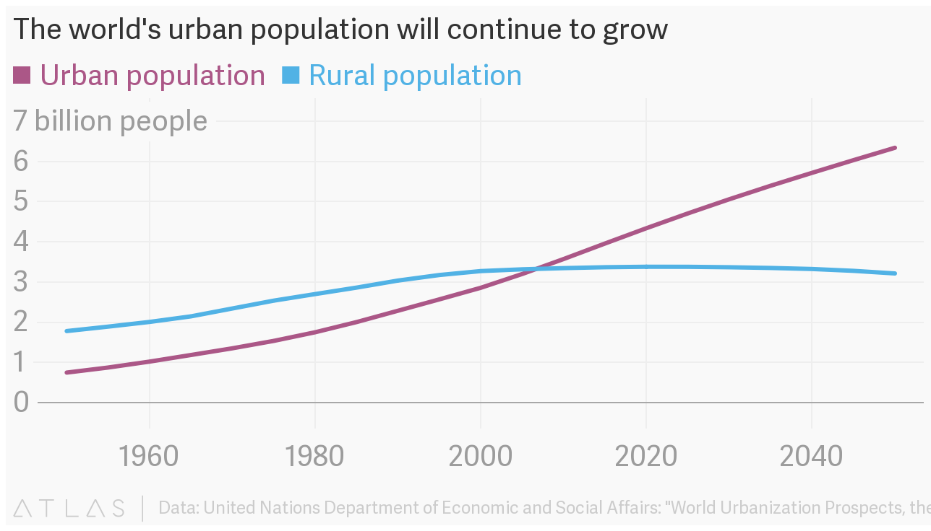
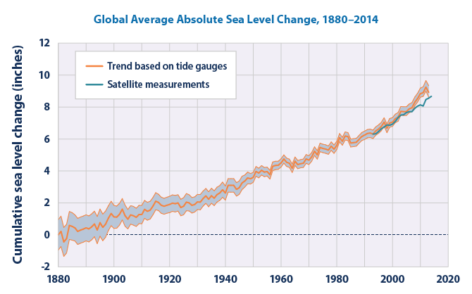
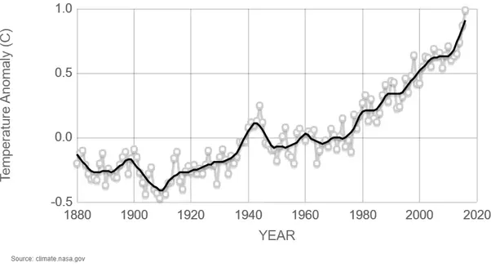
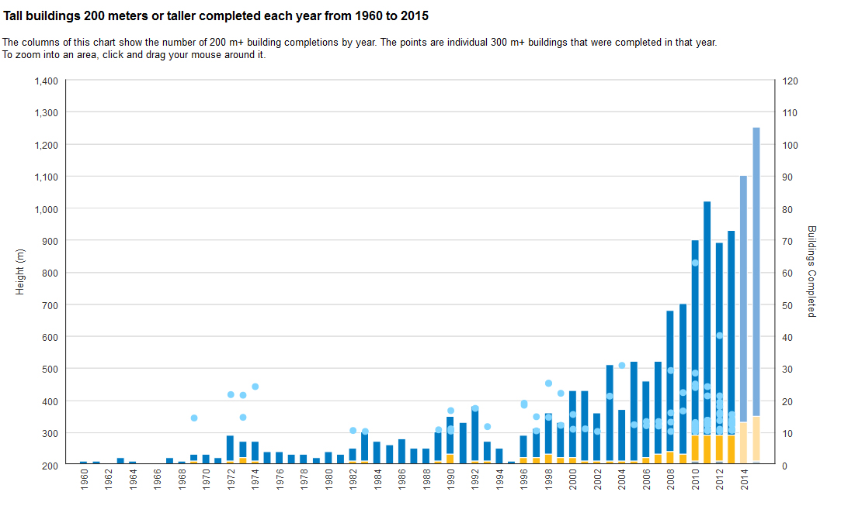
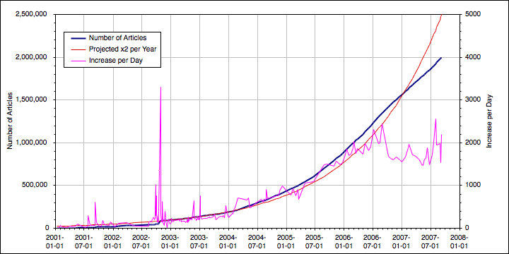
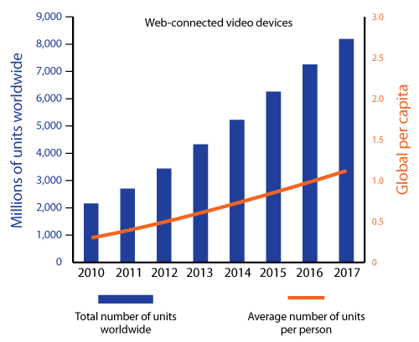

Slide 4
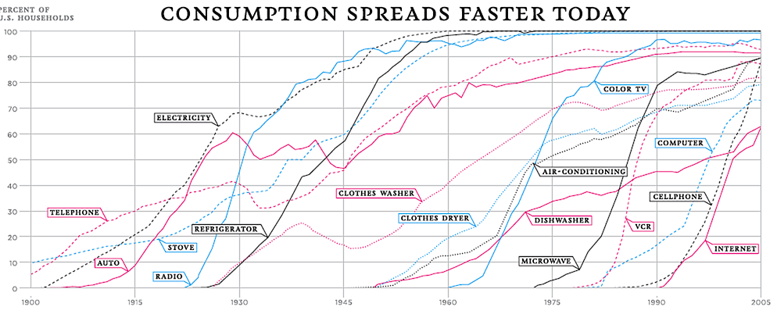

Slide 5
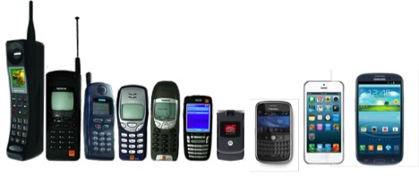
АРХИТЕКТУРАТА
И
ТЕХНОЛОГИЧНАТА АКСЕЛЕРАЦИЯ
ИСТОРИЯ НА МОБИЛНИТЕ ТЕЛЕФОНИ
1987-2013

Slide 6
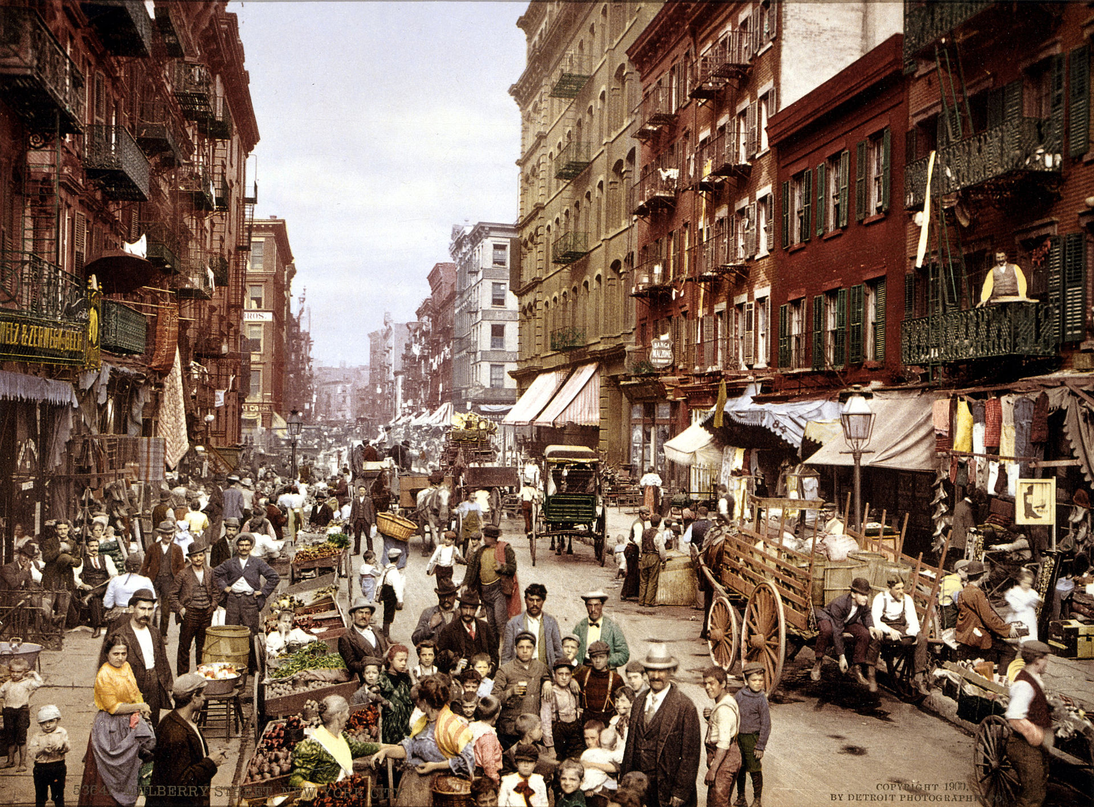

Slide 7
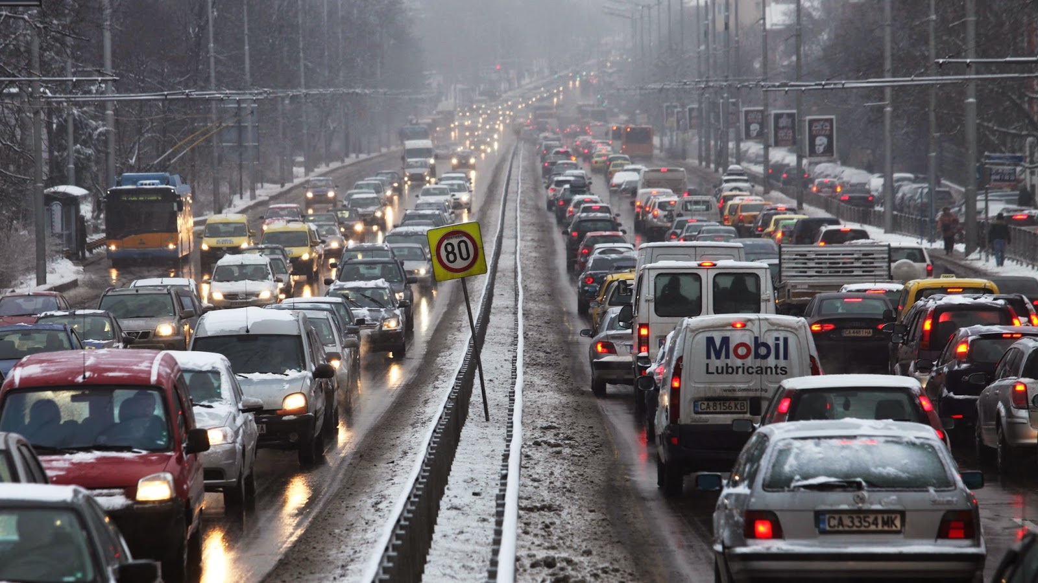

Slide 8
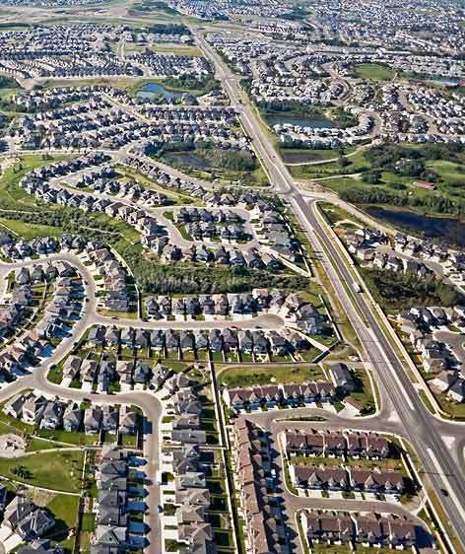
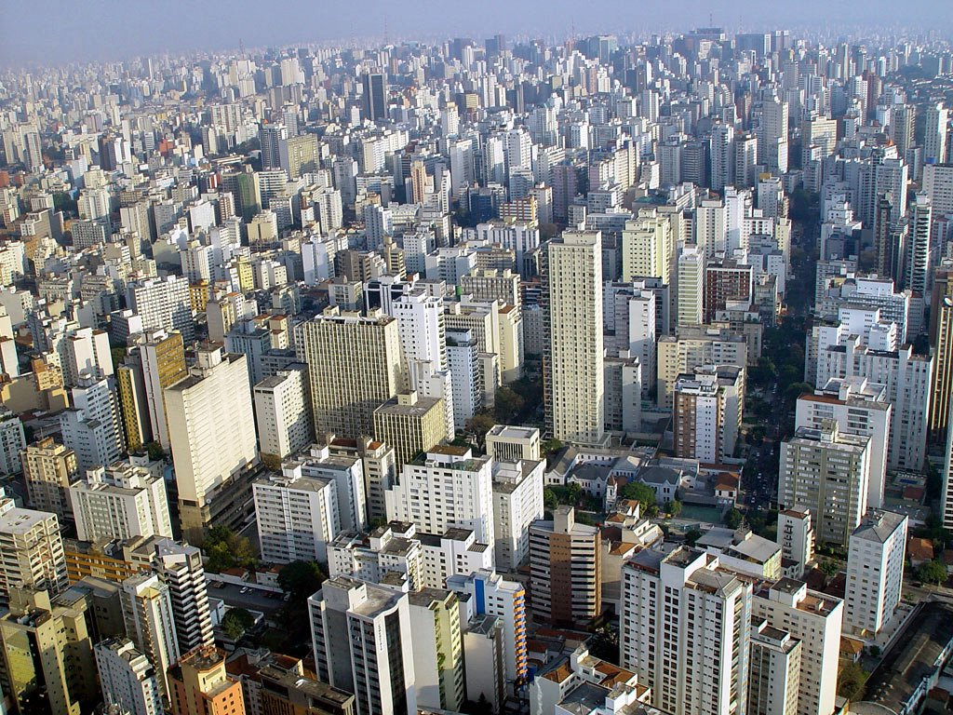
Horizontal Sprawl or Vertical Sprawl

Slide 9
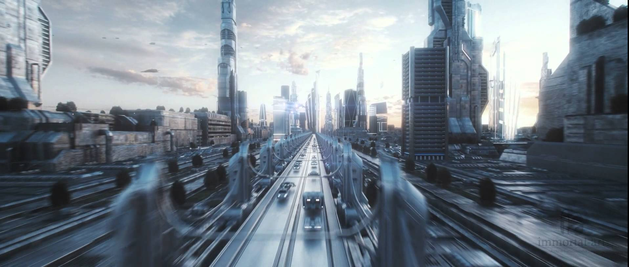

Slide 10
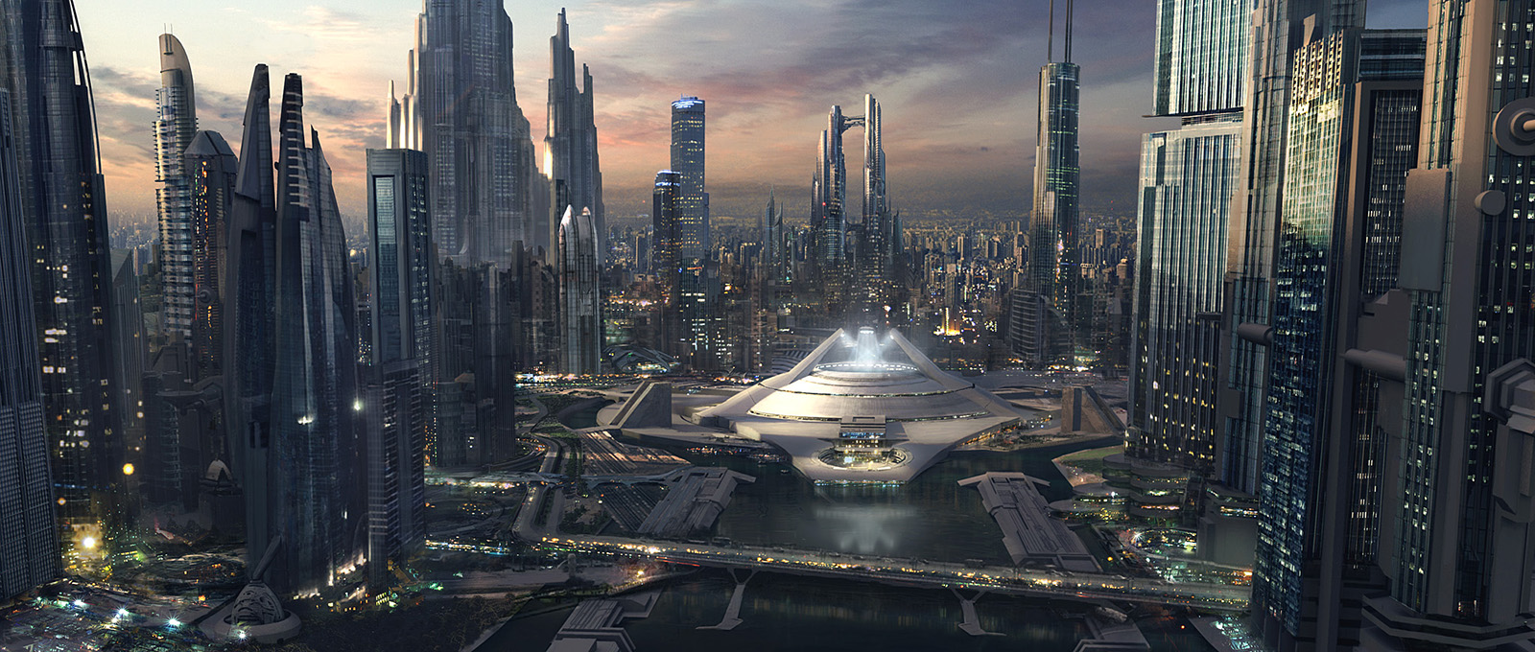

Slide 11
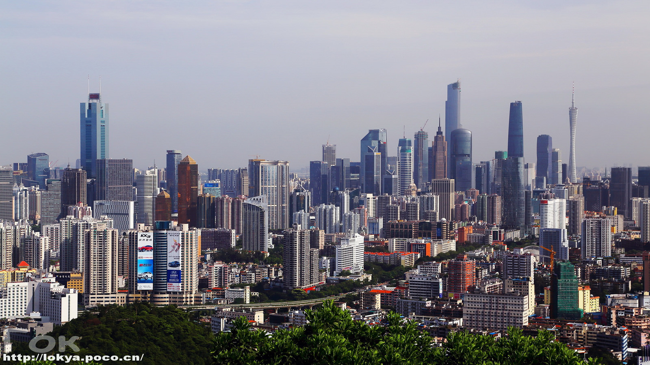

Slide 12
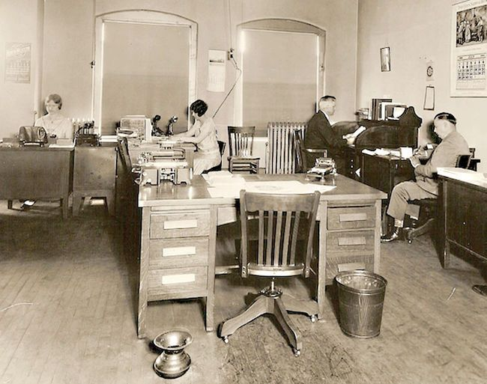

Slide 13
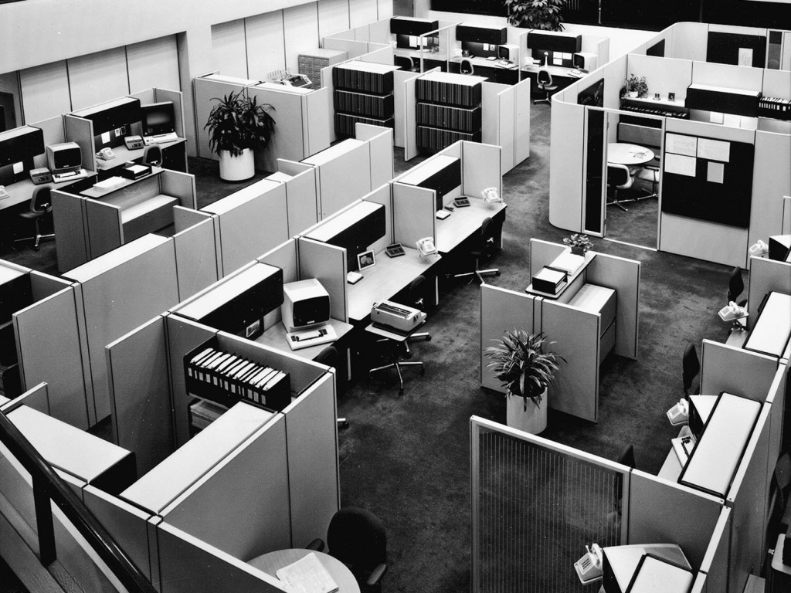

Slide 14
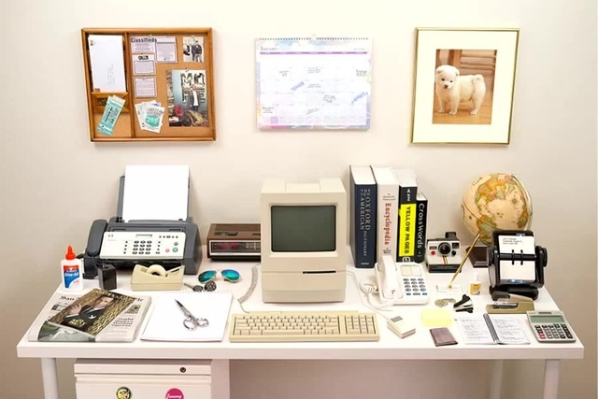

Slide 15
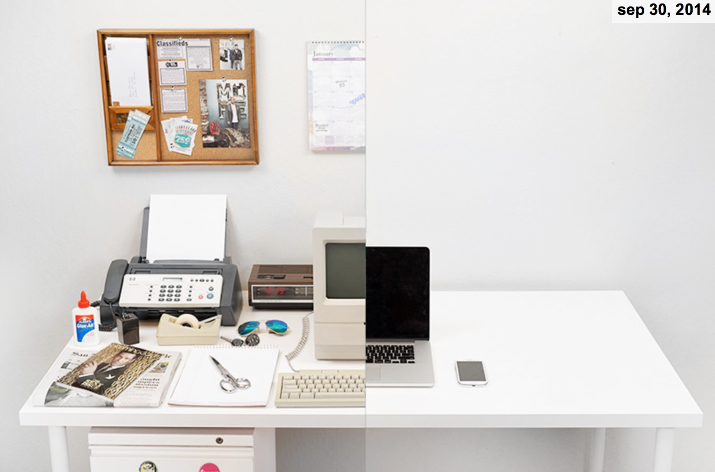

Slide 16
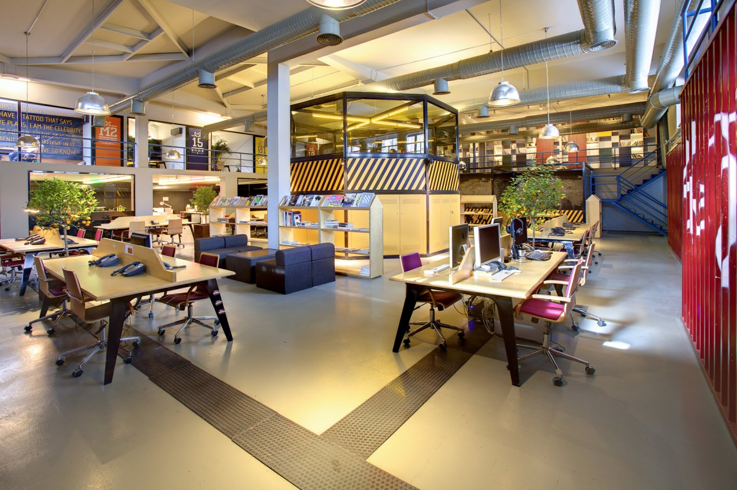

Slide 17
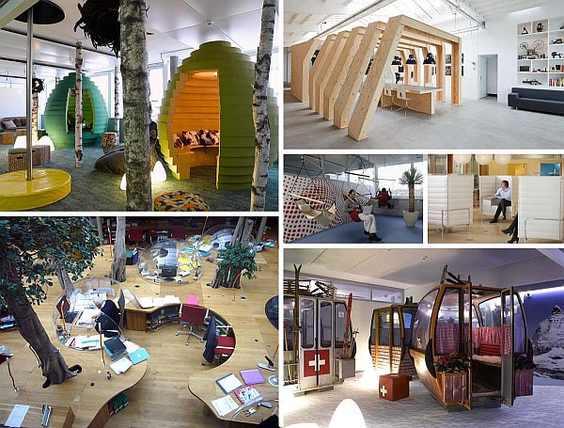

Slide 18
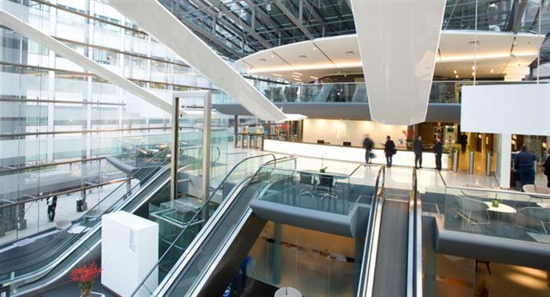

Slide 19
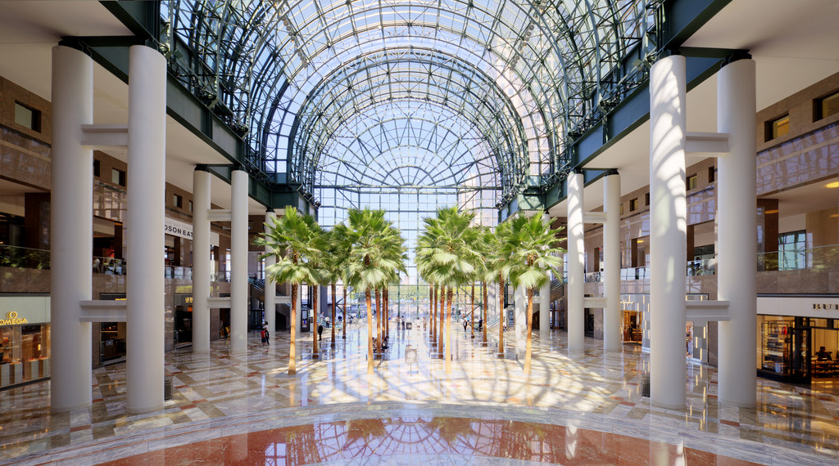

Slide 20
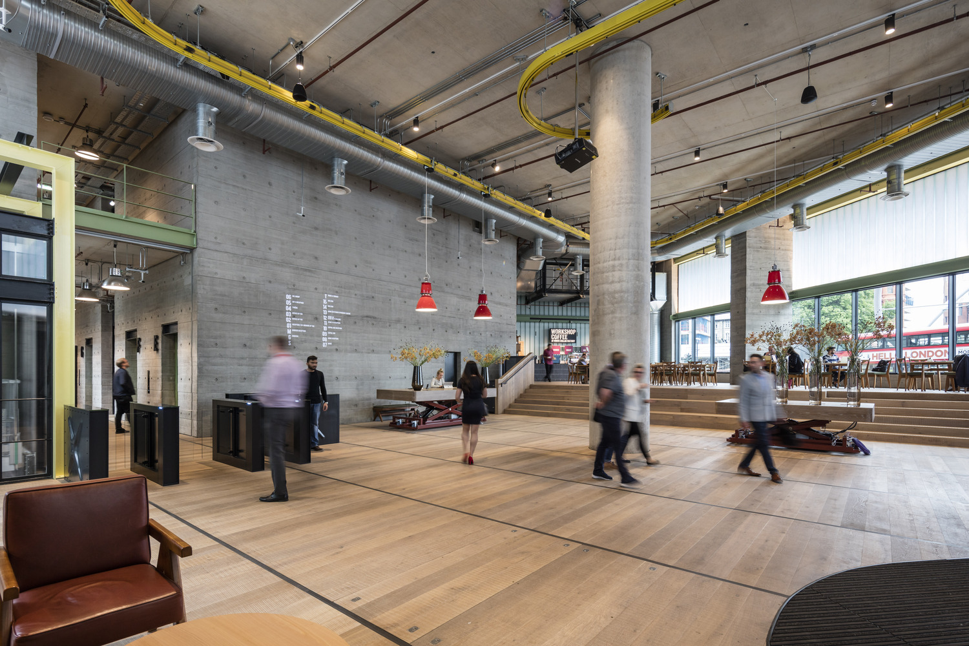

Slide 21
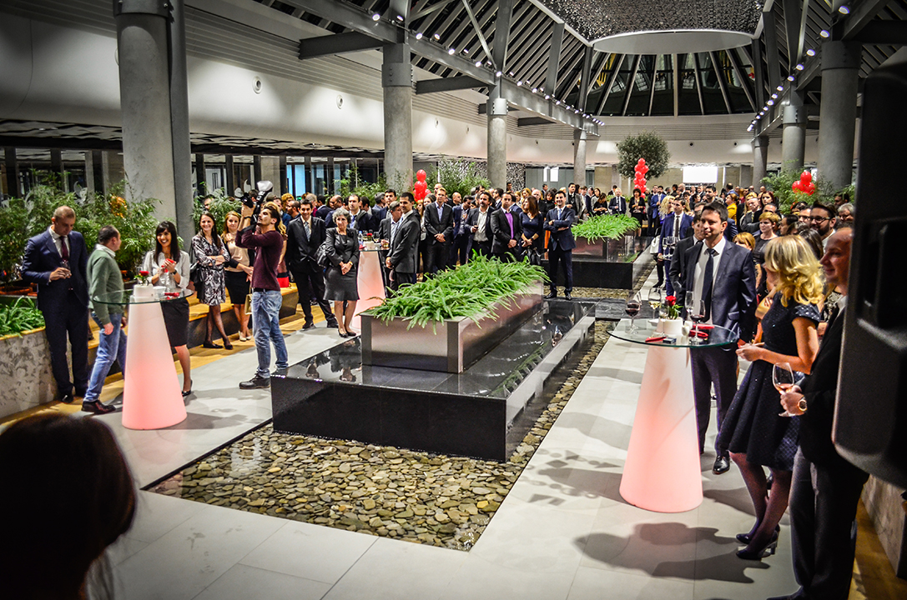
CAPITAL FORT
2008-2015

Slide 22
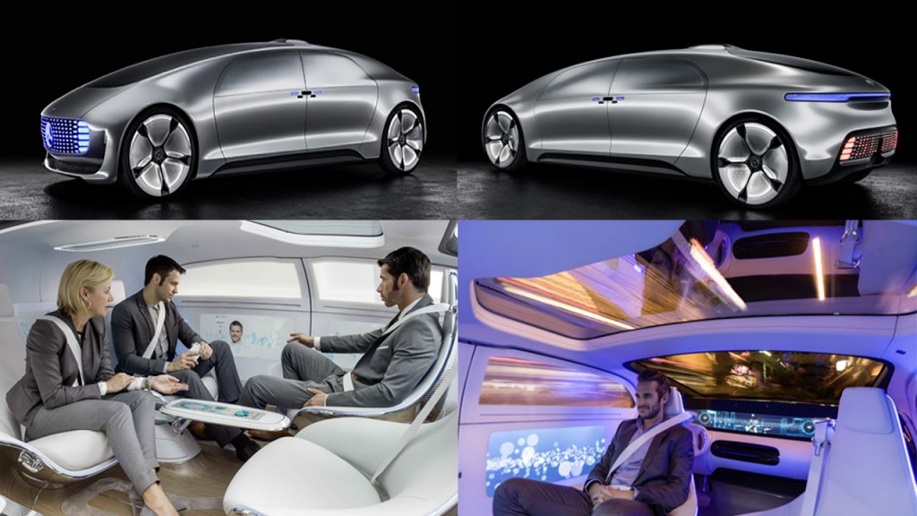
Driverless Cars Could Save Us from Ourselves (and Also from Each Other)

Slide 23
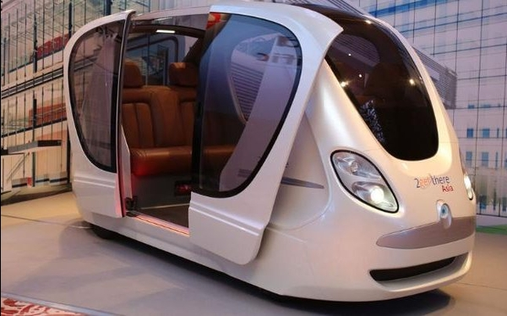
Singapore Gets The World's First 'Driverless' Taxis On The Streets. Can India Do The Same?

Slide 24
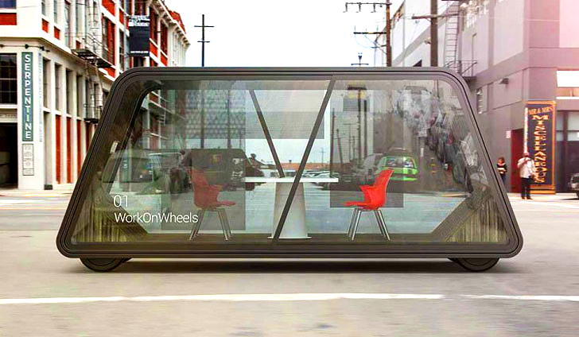
work pods on wheels

Slide 25
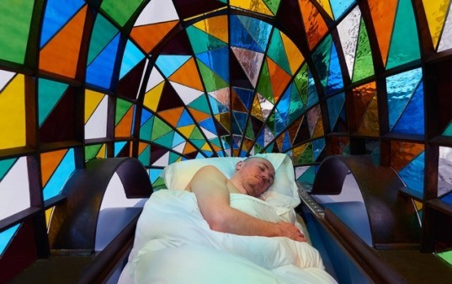
Amazing Self-Driving Stained Glass Car Lets You Sleep on the Way to Work!

Slide 26
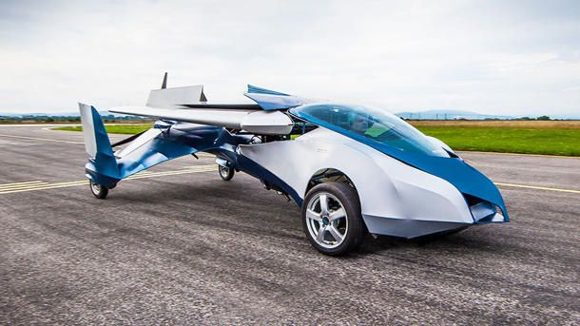
Aeromobil flying car goes from road to runway in style

Slide 27
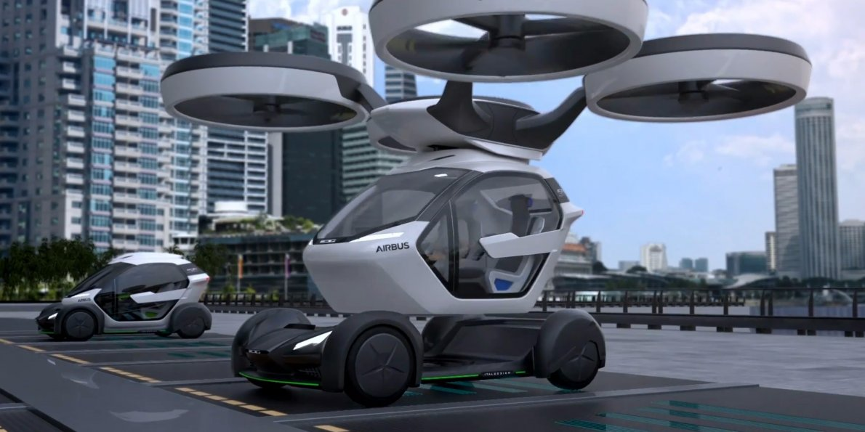
Aeromobil flying car goes from road to runway in style

Slide 28
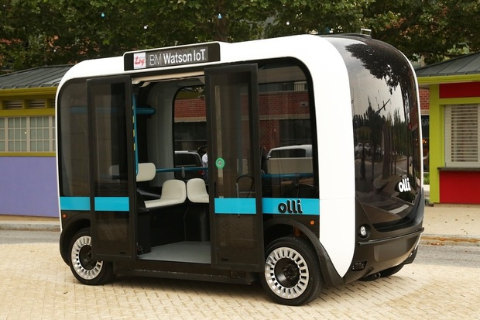

Slide 29
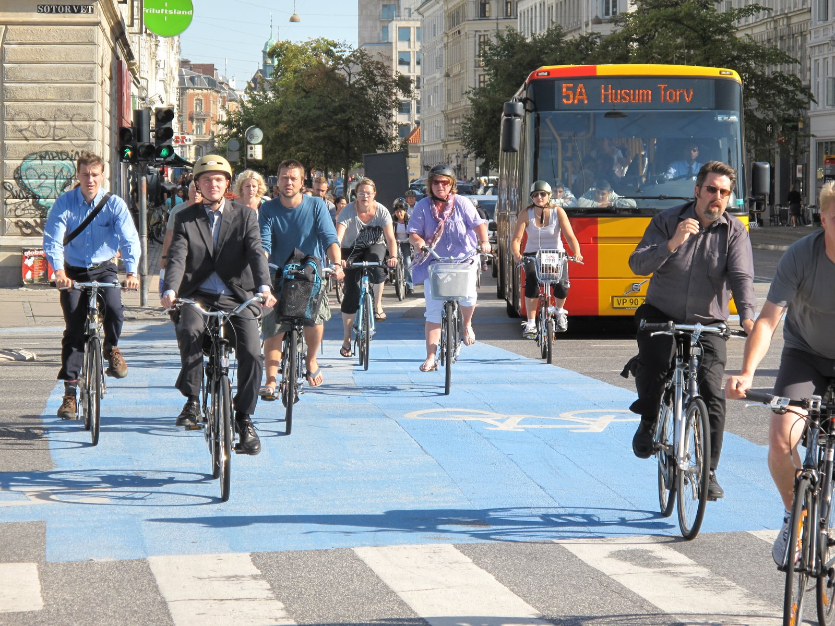

Slide 30
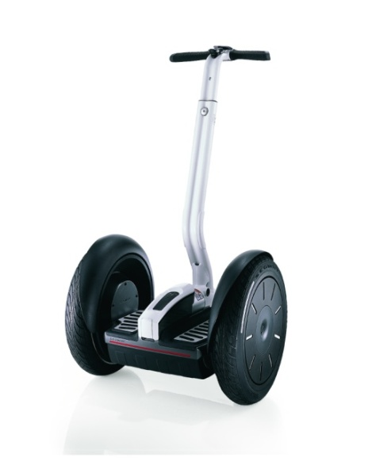
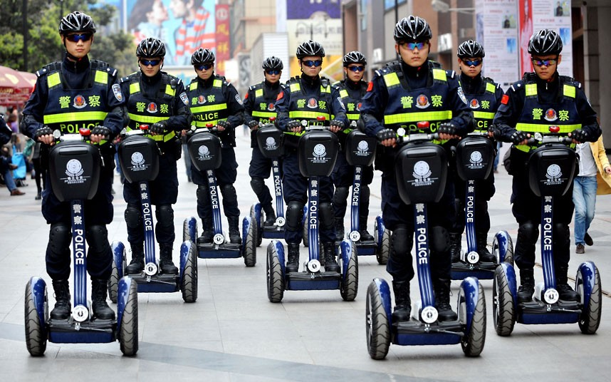
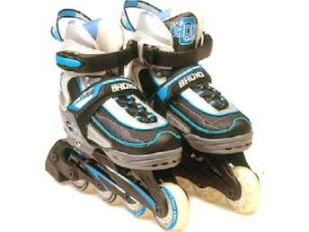
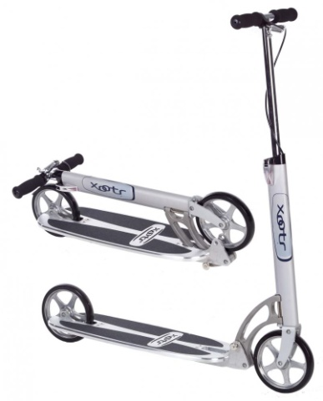

Slide 31
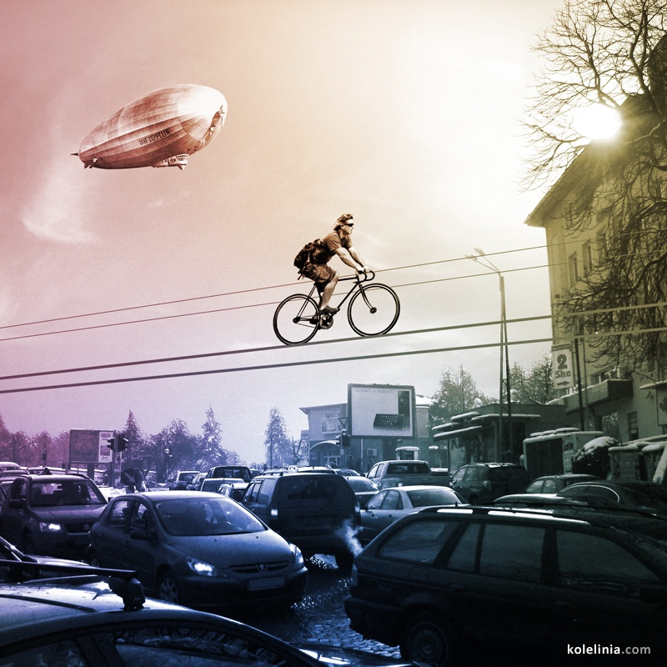

Slide 32
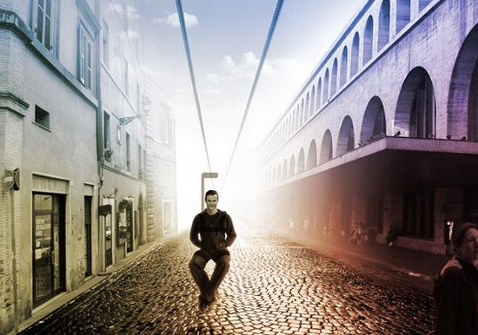
Personal Urban Transportation System is an electric backpack on wires

Slide 34
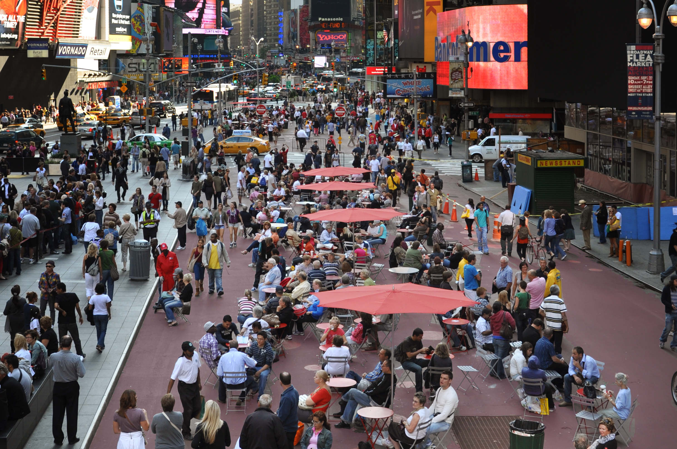

Slide 35
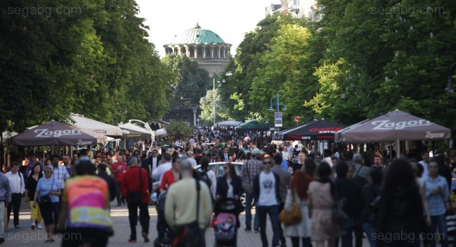

Slide 36
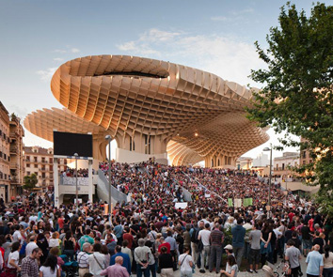
АТРАКТИВНИ ОБЩЕСТВЕНИ ПРОСТРАНСТВА

Slide 37
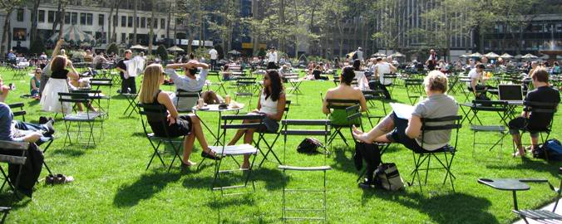
АТРАКТИВНИ ОБЩЕСТВЕНИ ПРОСТРАНСТВА

Slide 38
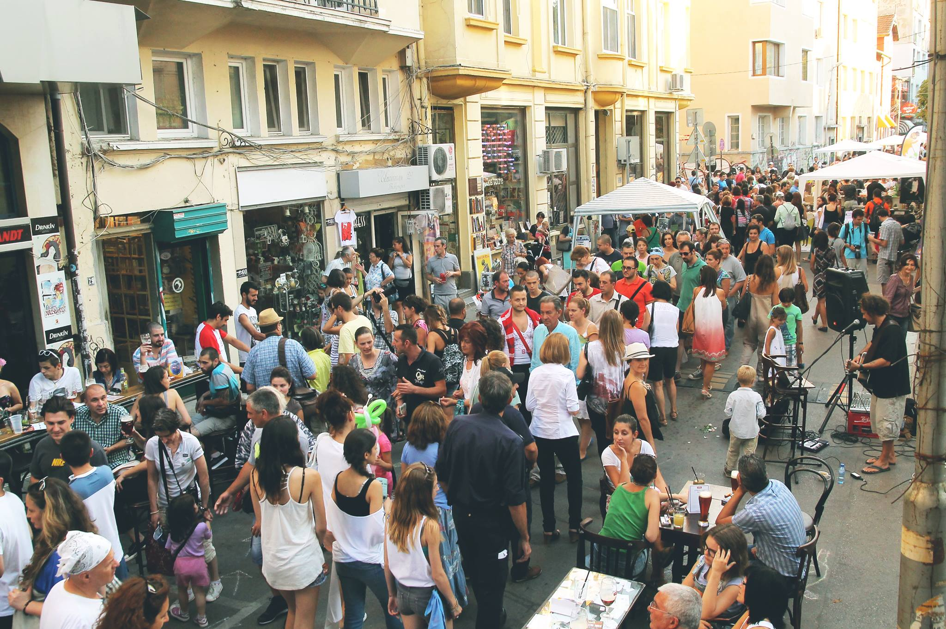

Slide 39
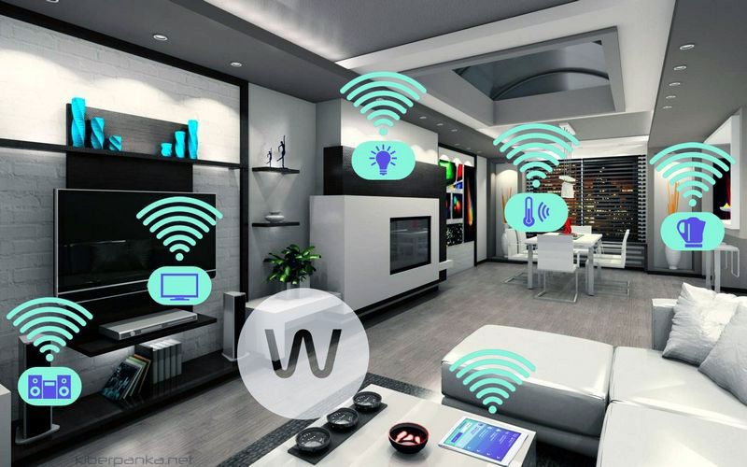

Slide 40
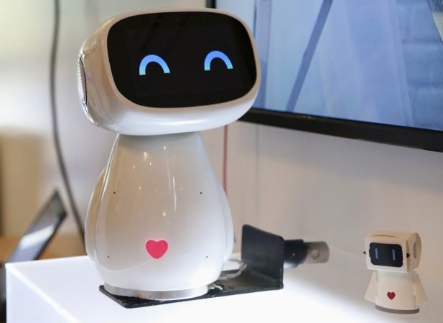

Slide 41
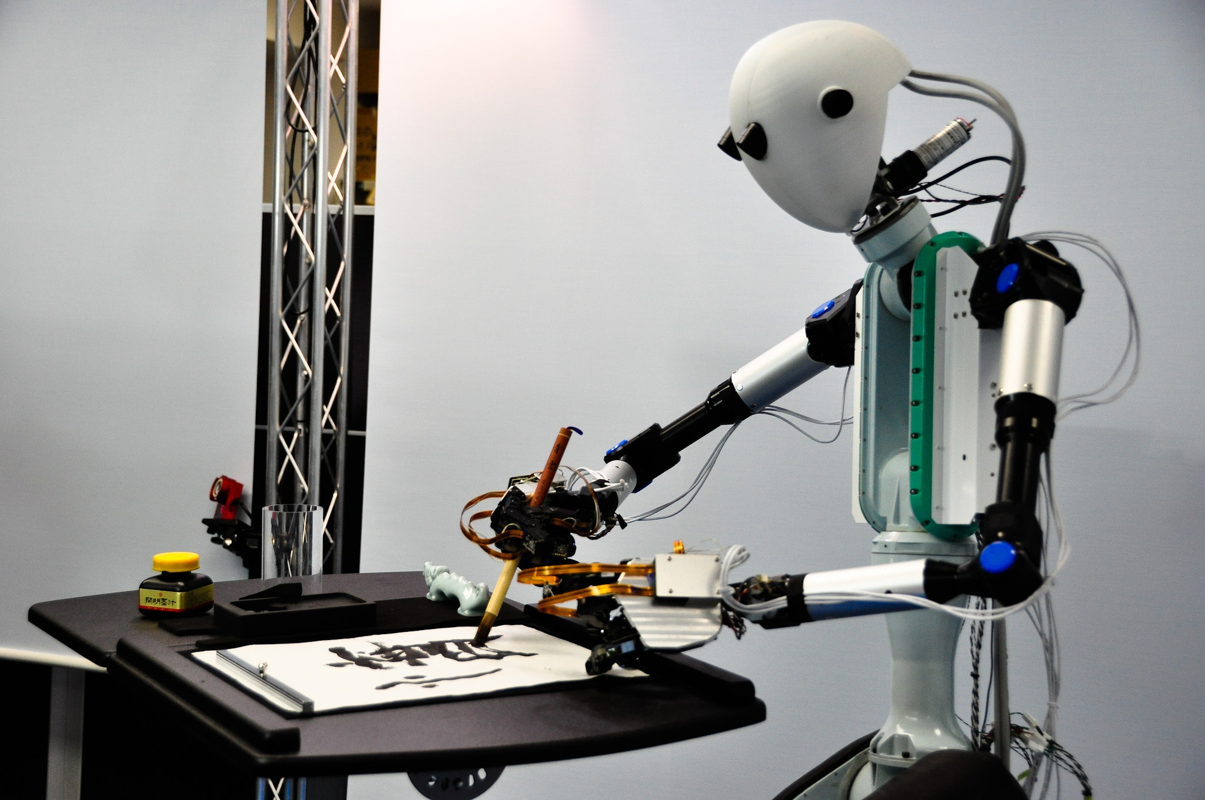

Slide 59
Thank You For The Attention!
ANGEL ZAHARIEV
A&A ARCHITECTS OOD
office@aaa.bg
www.aaa.bg

